Slide 1
IoT for Marinas
73%
July 2021

Slide 2
Marina IoT Background
IoT is a Tech-Trend
IoT stands for „Internet of Things“
The Internet of things are physical objects that are equipped with sensors, software, and other technologies that connect and exchange data with other devices over the Internet
For “us” it means with that new technology the vessel data can be remotely monitored by the owner!
IoT for Marinas
77%
2021

Slide 3
Marina IoT Background
ME-SENSE
IoT platform for Marinas (wireless connectivity)
Comprehensive evaluation of data for the owner
Cost-saving for ship owners for maintenance
Universal system, must function regardless of location
IoT for Marinas
77%
2021

Slide 4
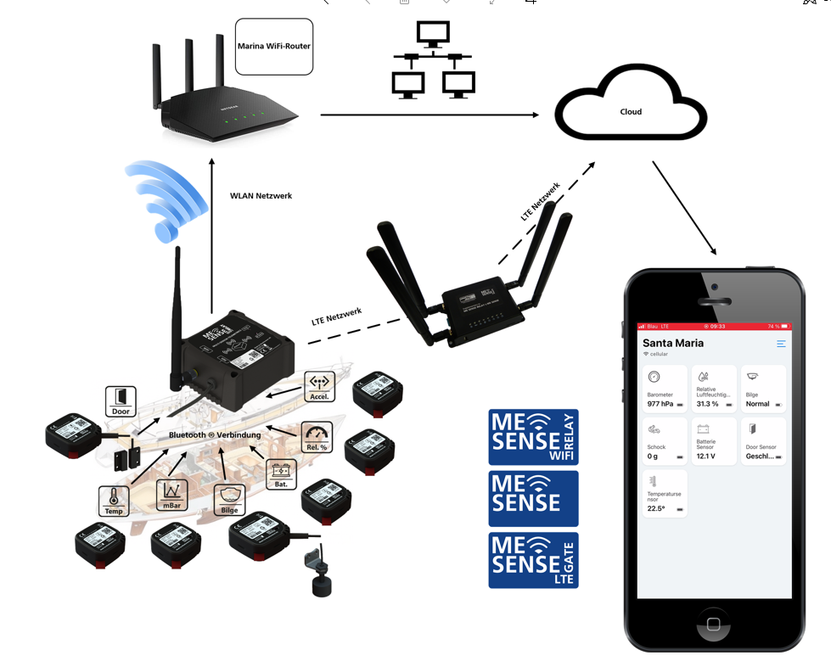
Hardware components Overview
Hardware
2021

Slide 5
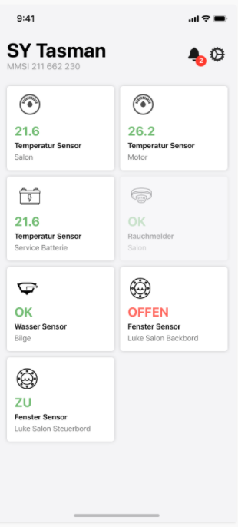
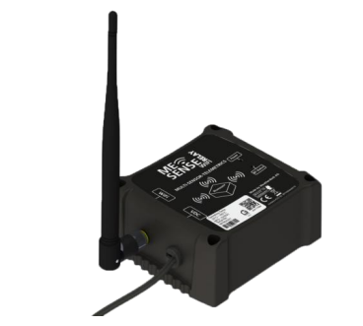
Data Flow overview
ME-SENSE Data
From different sensors in the vessel by Bluetooth to ME-SENSE Relay
ME-SENSE Relay
Collects the data and transmits the data over Wifi of the Marine (Alternatively LTE Gateway) to the Cloud
ME-SENSE APP
Data of the sensors of the vessel are displayed at the APP for IoS and Android
Hardware
2021

Slide 6
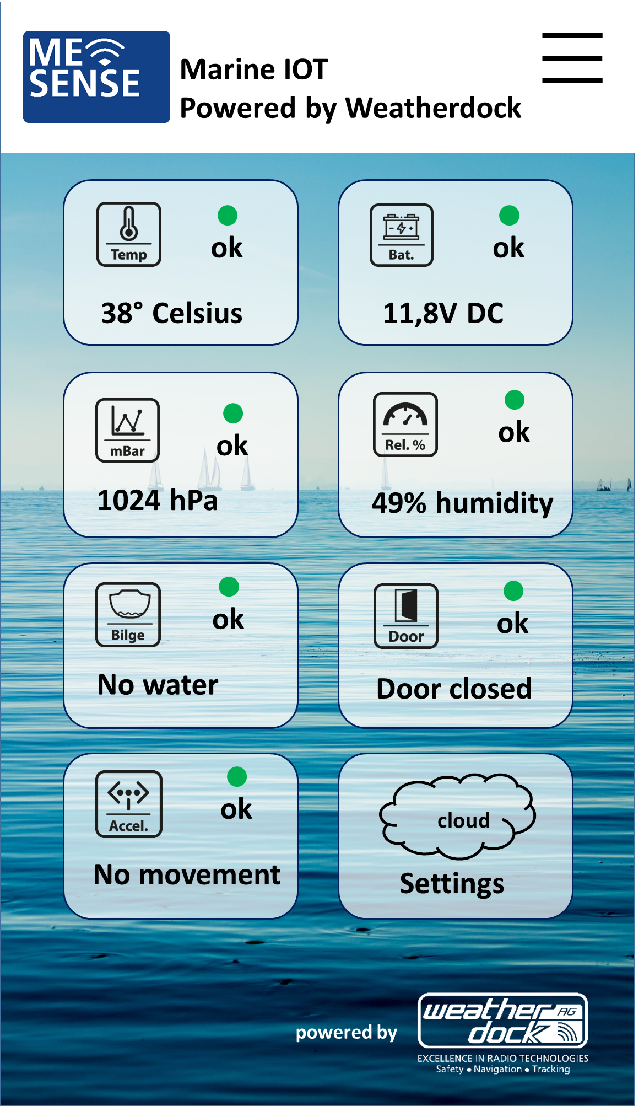
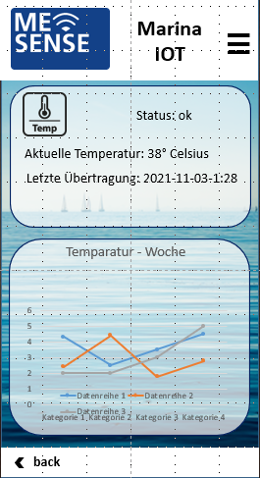
ME SENSE APP Operation
7 sensor datas in main display
push message at alert values
Selecting the sensor leads to detail page
Detail page shows actual value, last transmission time and weekly overview
Marina WIFI Access Point
IoT for Marinas
Marina
IoT -APP
87%
2021

Slide 7
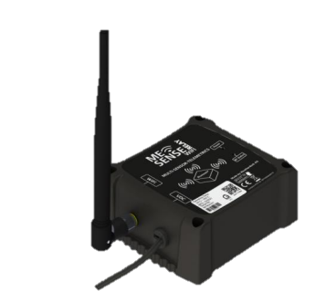
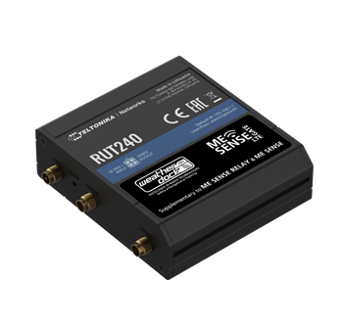
Hardware components Overview
Hardware
ME SENSE RELAY
Sensors
ME SENSE GATE
Measures the battery voltage of the boat
Collect Data from Sensor
Data transmission via WLAN
Up&Downlink to Sensors
Transmits via Bluetooth to ME SENSE RELAY
Temperature
Humidity
Bilge level
Door opening
Acceleration/shock
Air pressure
Connectivity if WLAN not sufficient
Worldwide connectivity
10 Years of operation included (option)
2021
ME SENSE GATE LTE

Slide 8
Unique Selling Points ME-SENSE
System Integrity:
All SW, HW, APP
Developed by Weatherdock
Worldwide communication standards:
WLAN, LTE, Bluetooth LE
Superb scalability:
Add or remove a sensor at any time with the APP
Marina WIFI Access Point
User friendly:
Configuration with APP, just scan the QR codes on devices
Highest availability:
10 minutes reporting
Alerts immediately via push message
Highest flexibility:
The set of sensors is free selectable. (e.g. 1 of each kind or 6 x temperature)
IoT for Marinas
Global connectivity:
With ME SENSE GATE SIM, 10 years global connectivity
User friendly:
Battery change at sensors simple: CR2450 coin cell
Highest quality:
Development, engineering, manufacturing in Germany
Marina
IoT -APP
Future hardware elements:
Switches, valve/switch position control, GPS, entry, smoke, gas, sound, infra red
Future APP services:
Marina administration,
90%
2021

